Slide 1
HOW TO CREATE A TECOM AUTHORIZATION
Cpl Hernandez Kuilan
DTS/GTCC CLERK
703-432-6687

Slide 2
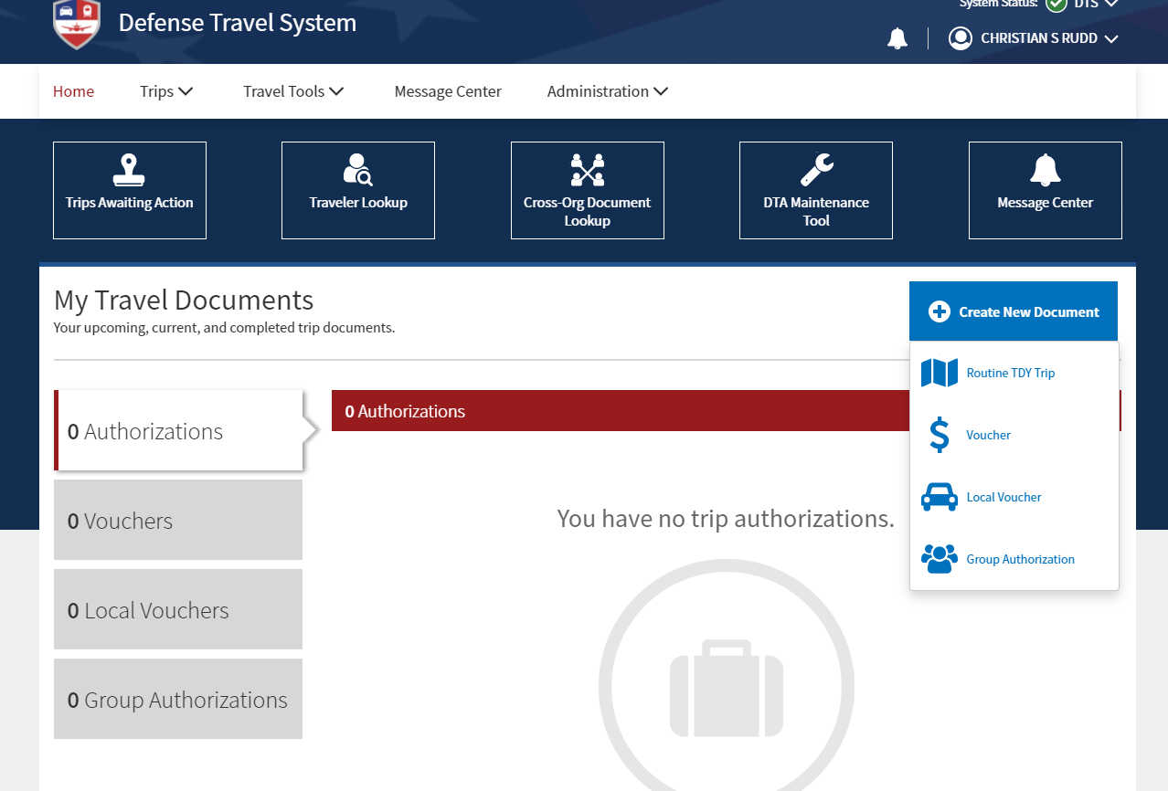
1. Create New Document
2. Routine TDY Trip

Slide 3
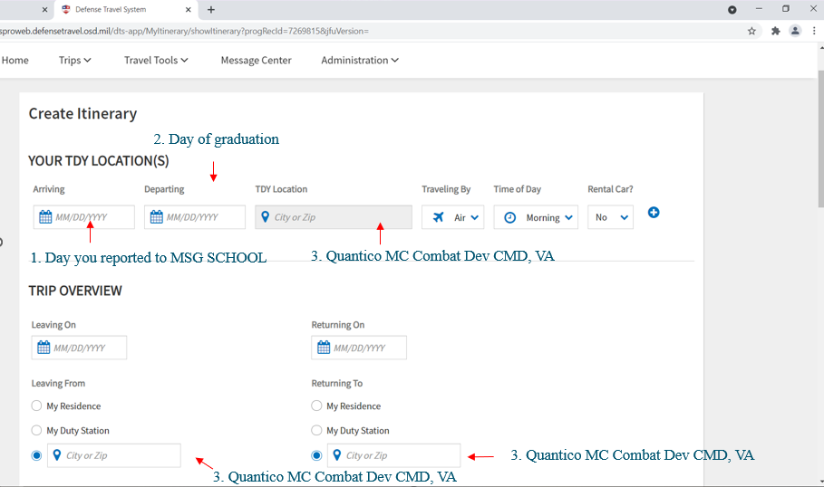
2. Day of graduation
1. Day you reported to MSG SCHOOL
3. Quantico MC Combat Dev CMD, VA
3. Quantico MC Combat Dev CMD, VA
3. Quantico MC Combat Dev CMD, VA

Slide 4
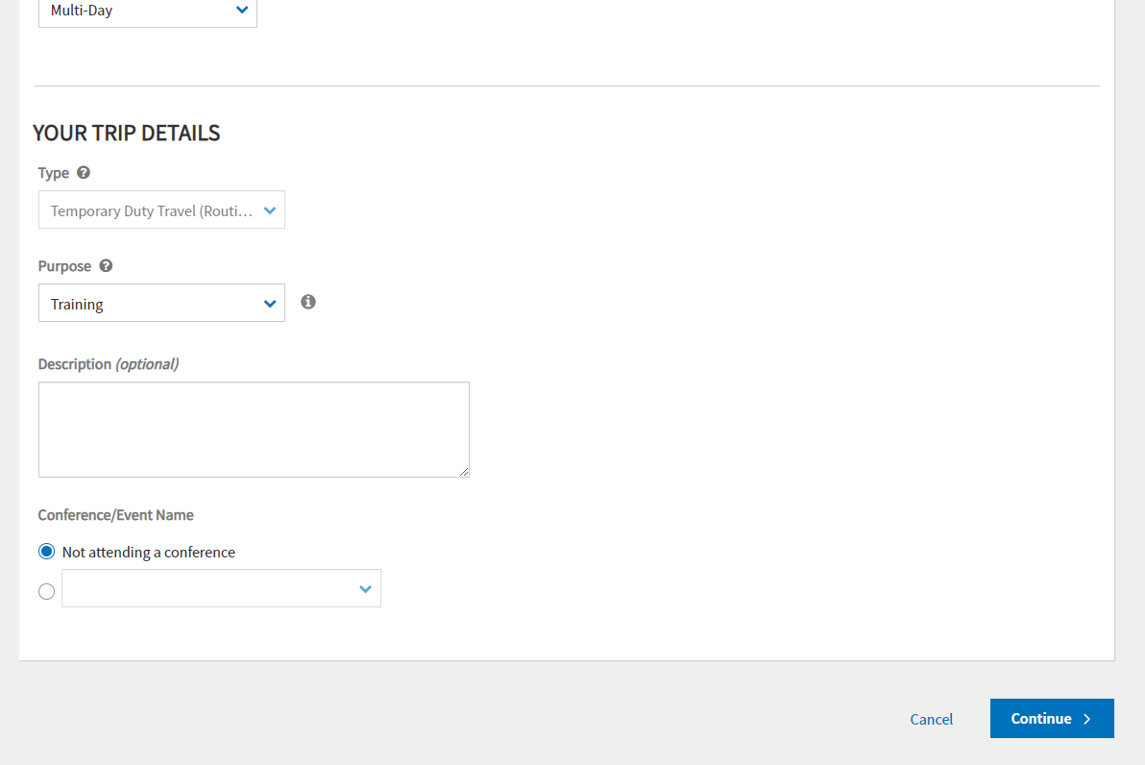
Drop down box (Training)
Class # MSG STUDENT
Write exactly as stated on the description provided
Ex. 5-21 MSG STUDENT

Slide 5
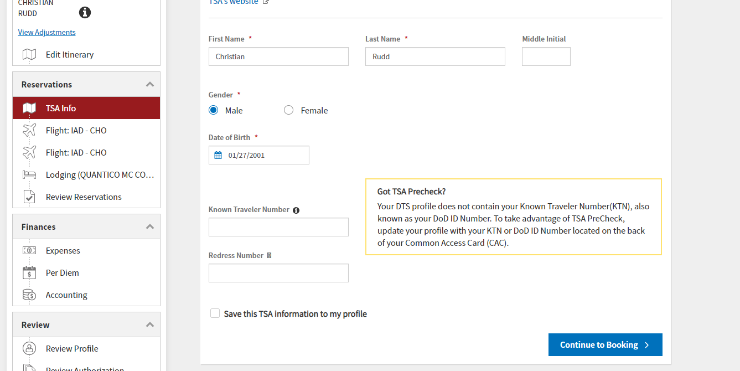
Nothing will be filled. Click continue

Slide 6
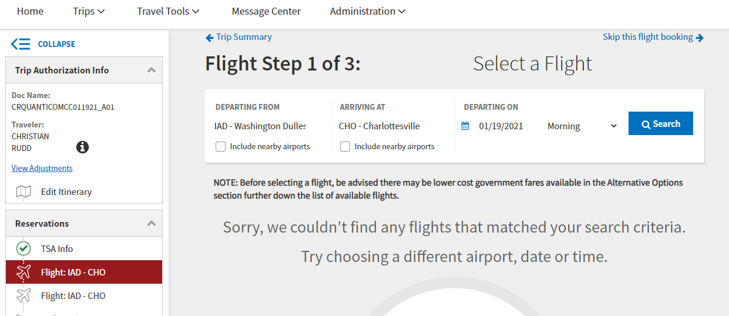
Skip booking

Slide 7
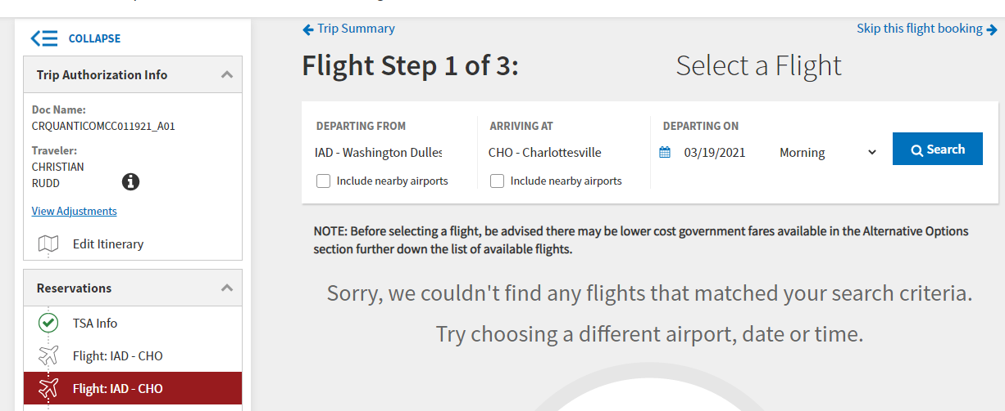
Skip booking

Slide 8
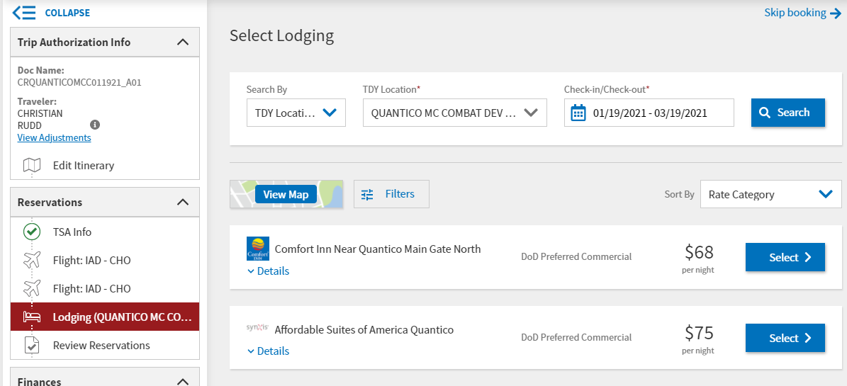
Skip booking

Slide 9
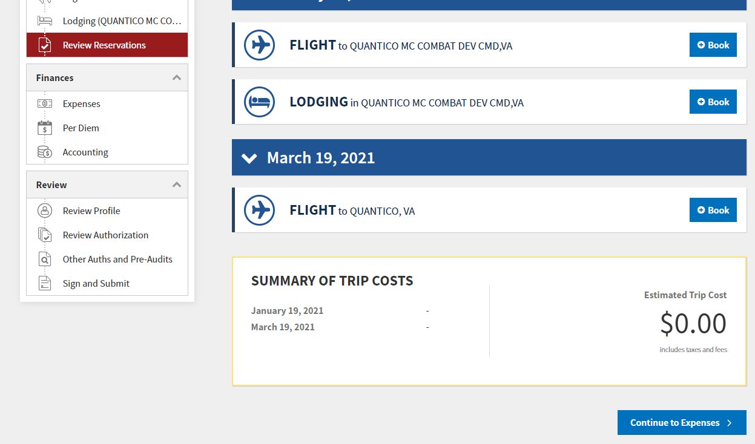
Scroll down and continue

Slide 10
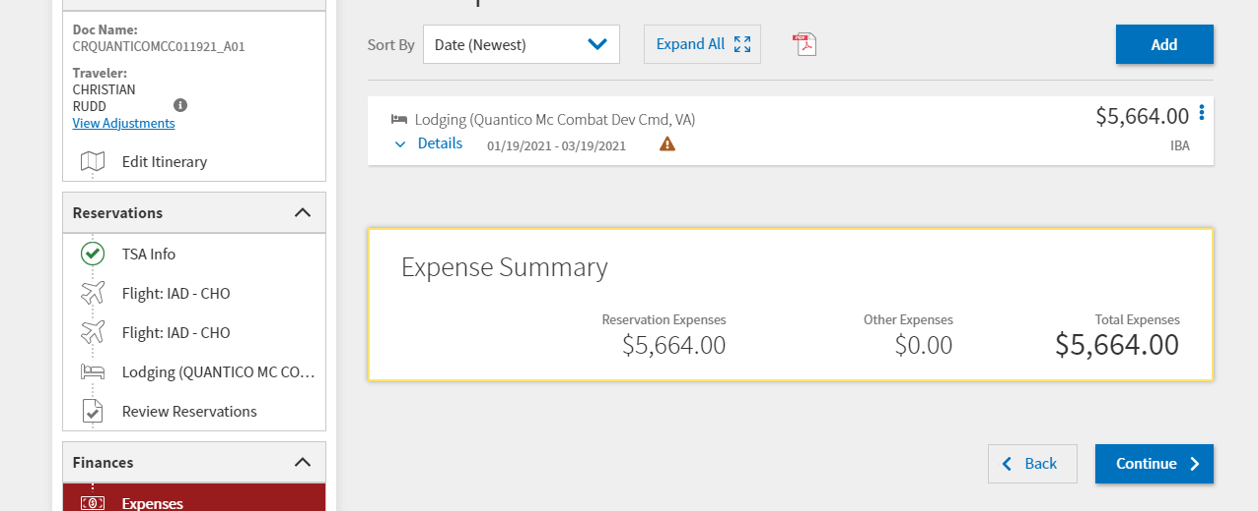

Slide 11
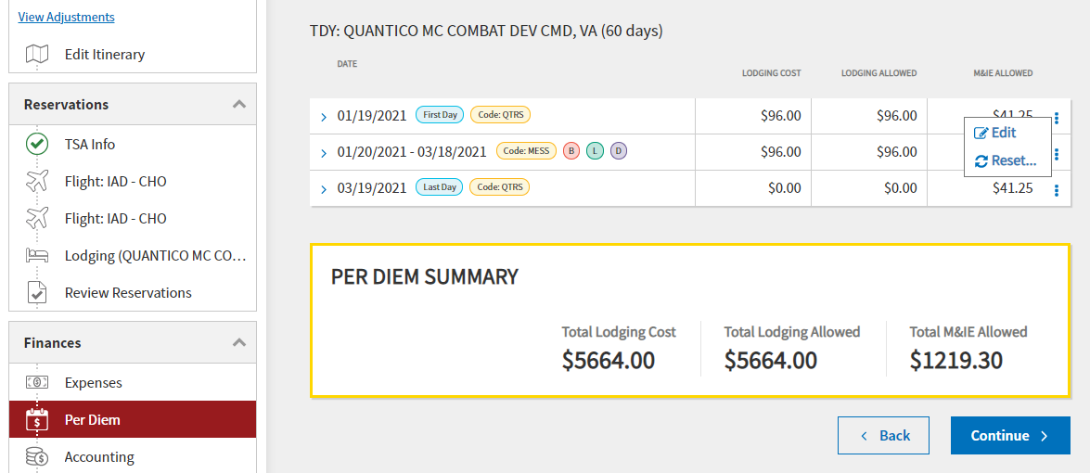

Slide 12
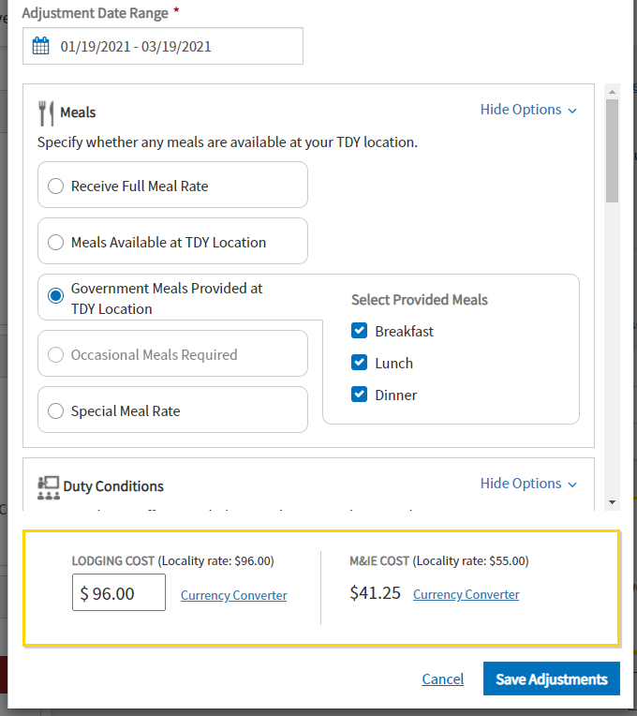
You will select reporting day until graduation date.
Scroll down

Slide 13
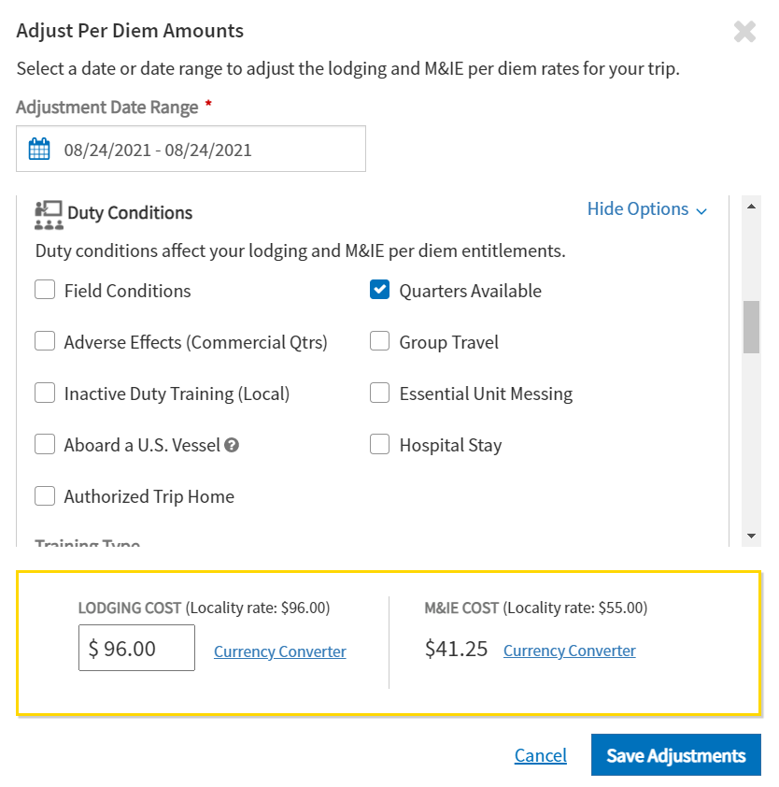
Scroll down

Slide 14
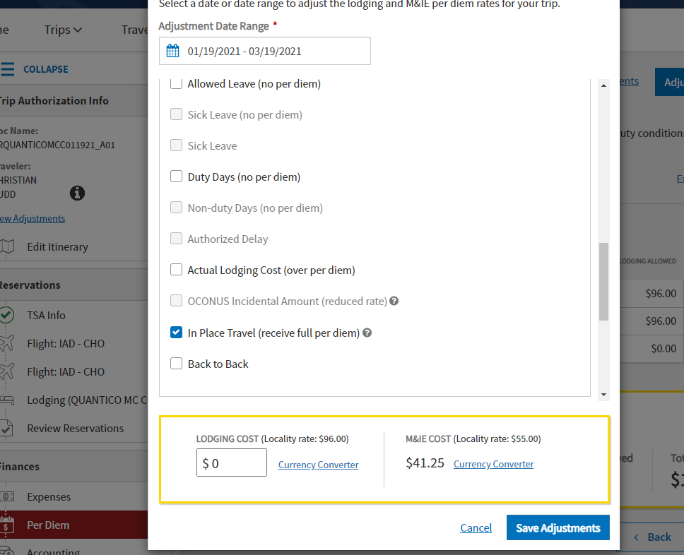
Delete 96 and type: 0.00. Then save adjustments.

Slide 15
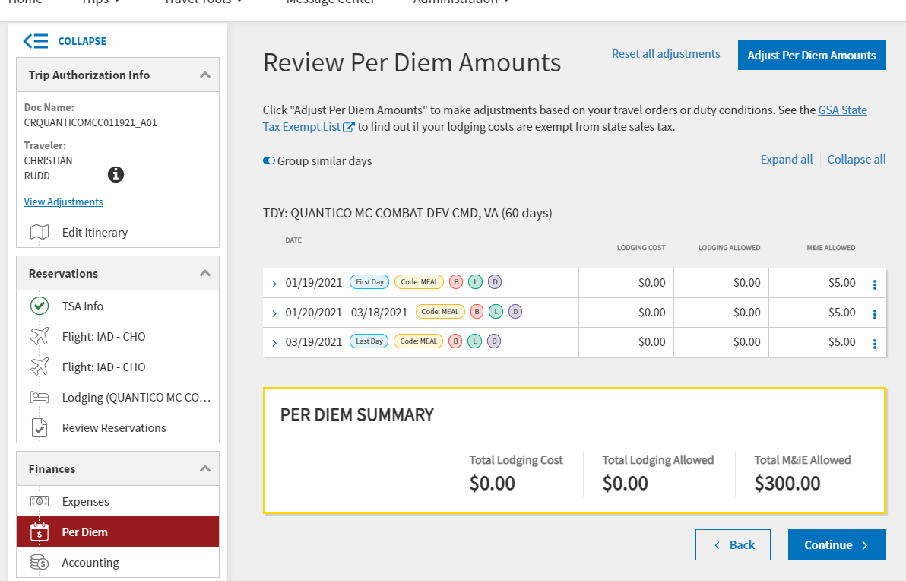

Slide 16
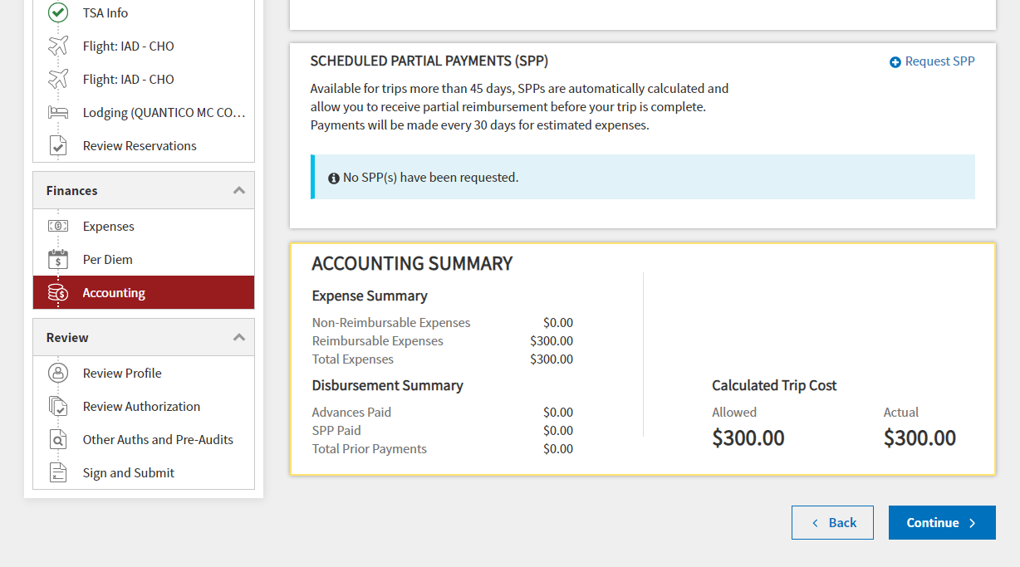

Slide 17
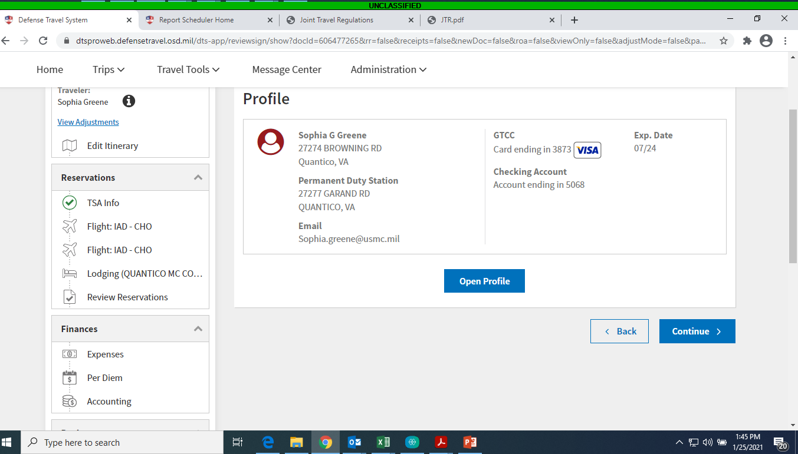
Ensure personal bank routing info is up to date.

Slide 18
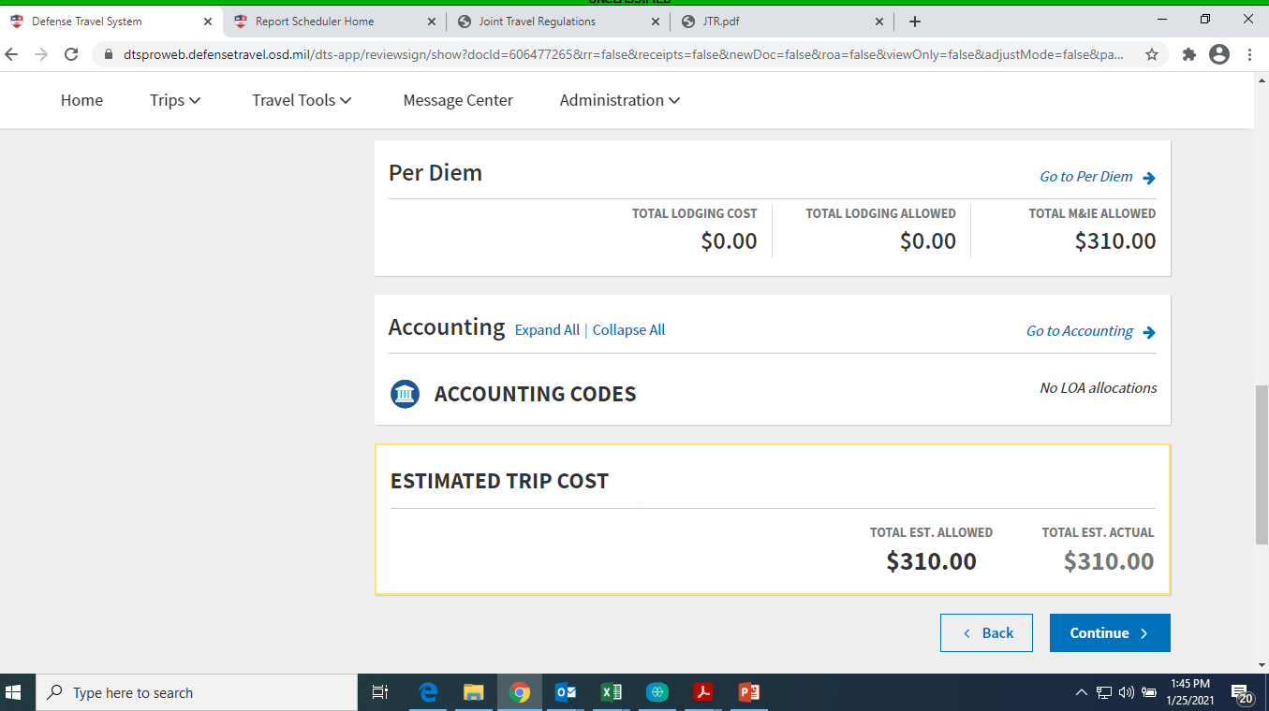
Scroll Down

Slide 19
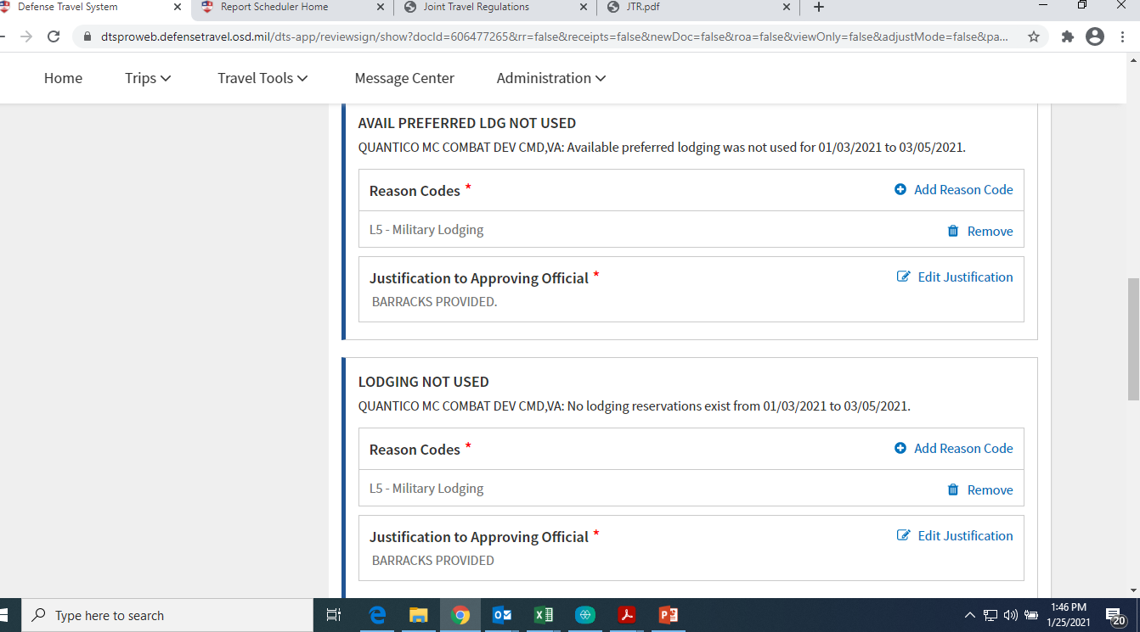
Add reason code
BARRACKS PROVIDED
Add reason code
BARRACKS PROVIDED

Slide 20
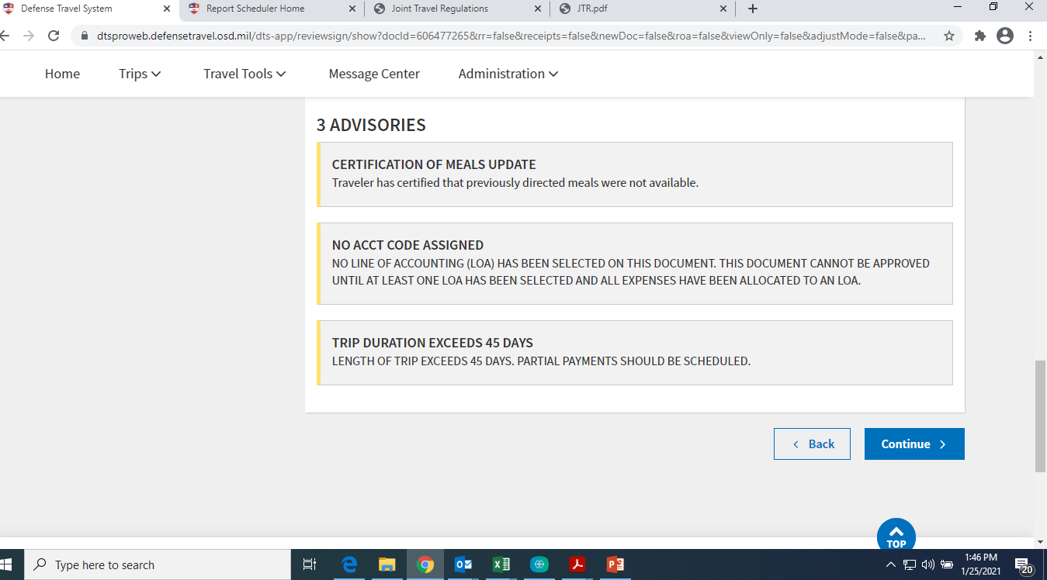
Scroll Down

Slide 21
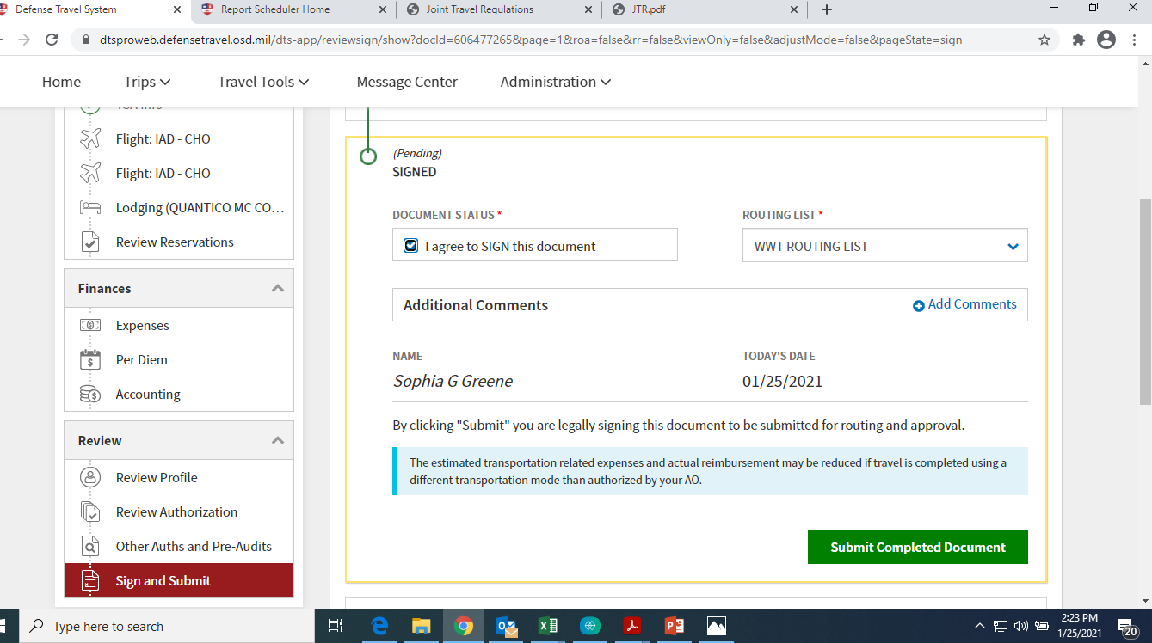
2.
1. Select WWT Routing List
3.

